Slide 1
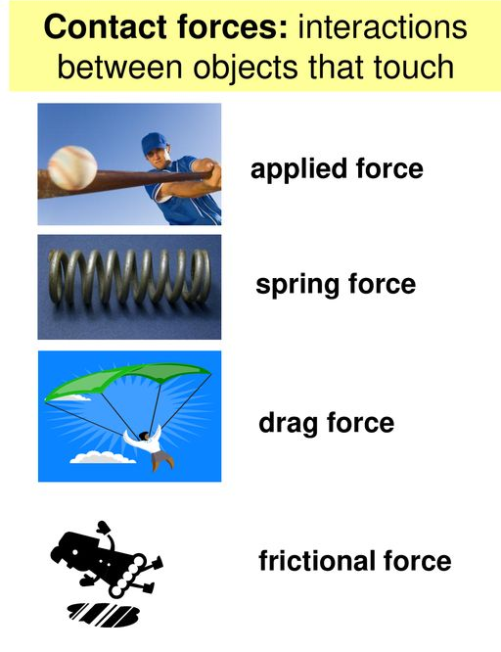

Contact Forces Question
Explain what contact forces are and give examples.
_______________________________________________________________________________________________________________________________________________________________________________________________________________________________________________________________________________________________________________________________________________________________________________________________________________________________________
Answer
Link to video

