Slide 1
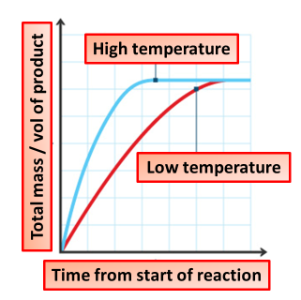

How Temperature Affects Rate Question
The diagram shows how temperature affect the rate of reaction. Explain how temperature affects the rate of a chemical reaction.
Key things to include:
What effect does increasing temperature have on kinetic energy
How does this affect the number of collisions
_______________________________________________________________________________________________________________________________________________________________________________________________________________________________________________________________________________________________________________________________________________________________________________________________________________________________________
Answer
Link to video

