Slide 1
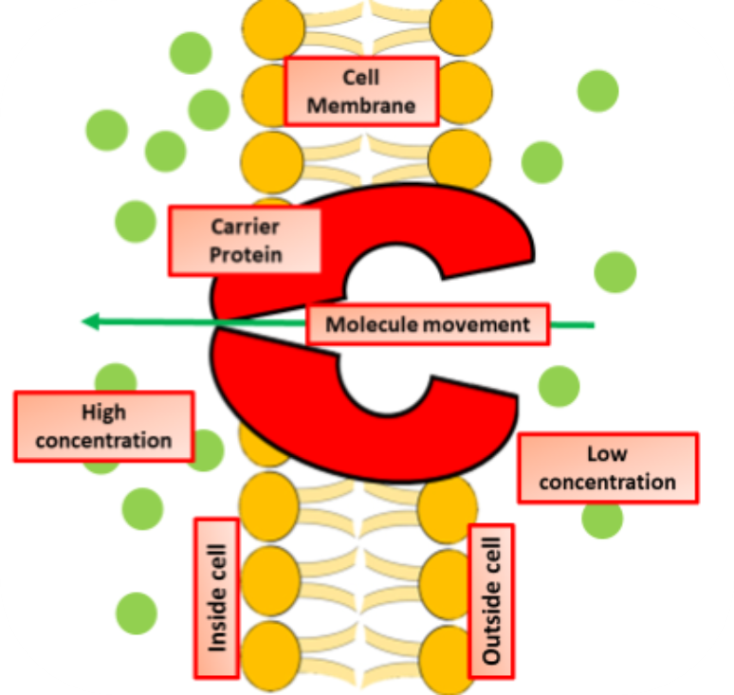
Active Transport Question
The diagram shows what happens during active transport:
Does active transport require energy?
In active transport, do particles move from low concentration to high concentration or high to low?
What cell structure provides energy for active transport?
What substance in the soil is absorbed by plant roots using active transport?
Mark Scheme

