Slide 1
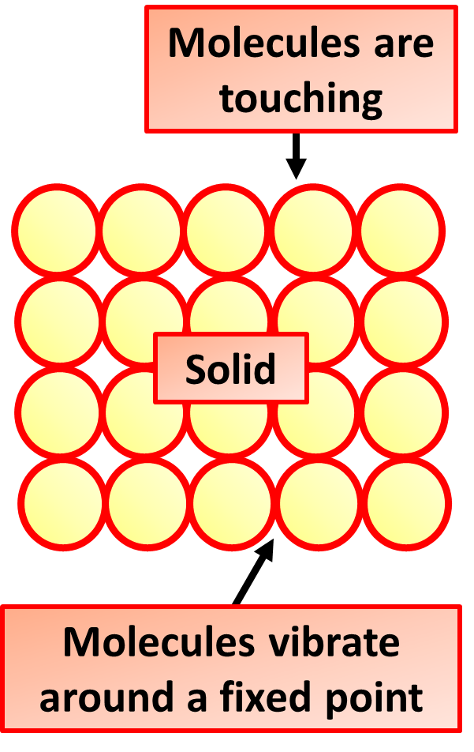

Solid Properties Question
The diagram shows how the particles in a solid are arranged. Describe the properties of particles in solids and how these properties explain solid behaviour
Key things to include:
Describe the distribution of particles
Describe the movement of particles
What effect will this have on it’s properties
________________________________________________________________________________________________________________________________________________________________________________________________________________________________________________________________________________________________________________________________________________________________________________________________________________________________________
Answer
Link to video

