Slide 1
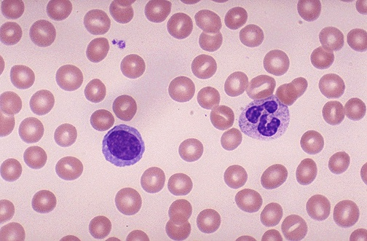

Blood Slides Question
Describe how to produce a blood slide for examination under a light microscope.
____________________________________________________________________________________________________________________________________________________________________________________________________________________________________________________________________________________________________________________________________________________________________________________________________________________________________________________________________________________________________________________________________________________________________________________
Answer
Video link

