Slide 1

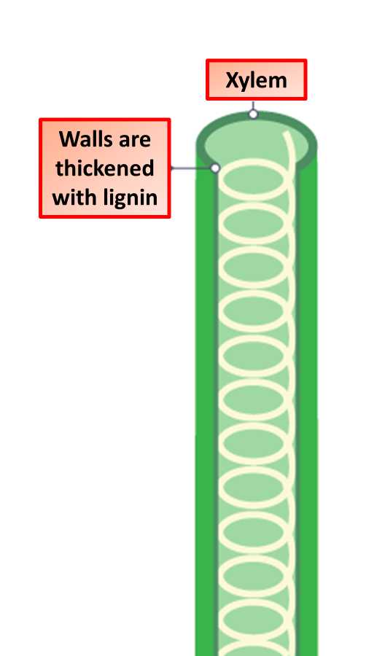

The Great Biology Pubish Quiz
Xylem

Slide 2

The Great Biology Pubish Quiz
Xylem
What is the main function of xylem?
A
Transport of water
Transport of sugars
B
C
Absorption of minerals
D
Support of the plant

Slide 3
The Great Biology Pubish Quiz
Xylem
What is the structure of xylem vessels?
A
Living cells with thickened walls
Dead cells with thickened walls
B
C
Living cells with thin walls
D
Thin-walled cells arranged in a ring

Slide 4
The Great Biology Pubish Quiz
Xylem
Which substance is found in the walls of xylem vessels?
A
Lignin
Cellulose
B
C
Chitin
D
Starch

Slide 5
The Great Biology Pubish Quiz
Xylem
Which direction does water move in xylem vessels?
A
Up from roots to leaves
Down from leaves to roots
B
C
Sideways between cells
D
All directions in the plant

Slide 6
The Great Biology Pubish Quiz
Xylem
What type of cell makes up xylem vessels?
A
Parenchyma
Sclerenchyma
B
C
Phloem elements
D
Tracheids and vessels

Slide 7
The Great Biology Pubish Quiz
Xylem
Which process is primarily responsible for water movement in the xylem?
A
Active transport
B
Osmosis
C
Cohesion and adhesion
D
Diffusion

Slide 8

The Great Biology Pubish Quiz
Xylem
Question 1
A
Question 2
B
Question 3
A
Question 4
A
Question 5
D
Question 6
C

