Slide 1
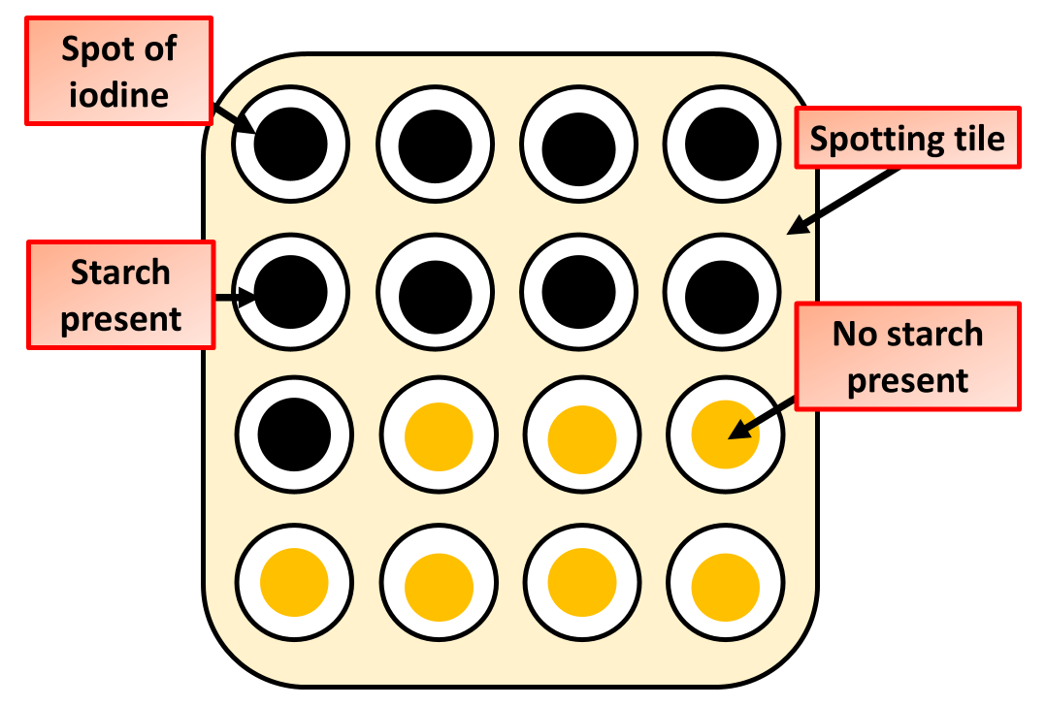
The Effect of Substrate Conc. on Rate of Enzyme Controlled Reaction Question
Describe how you would investigate the effect of substrate concentration on the rate of an enzyme-controlled reaction in a practical activity
____________________________________________________________________________________________________________________________________________________________________________________________________________________________________________________________________________________________________________________________________________________________________________________________________________________________________________________________________________________________________________________________________________________________________________________
Answer
Link to video

