Slide 1
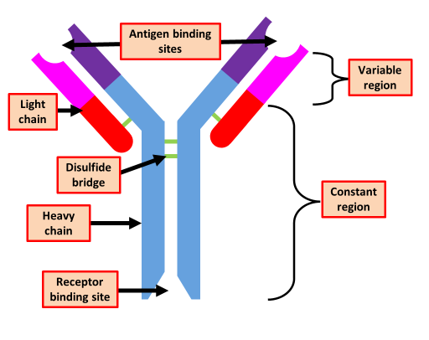

Antibody Action Question
Describe how antibodies help to defend the body against pathogens.
___________________________________________________________________________________________________________________________________________________________________________________________________________________________________________________________________________________________________________________________________________________________________________________________________________________________________________________________________________________________________________________________________________________________________________________________________________________________________
Answer
Link to video

