Slide 1
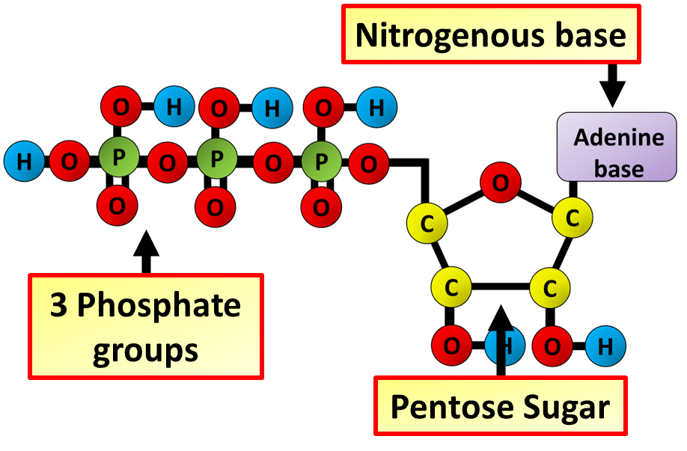
ATP Question
The diagram below shows the structure of ATP. Describe the role of ATP in cells and explain why it is an efficient energy carrier.
________________________________________________________________________________________________________________________________________________________________________________________________________________________________________________________________________________________________________________________________________________________________________________________________________________________________________________________________________________________________________________________________________________________________________________________________________________________________________________________________________________________________________________________________________________________________________________
Answer
Link to video

