Slide 1
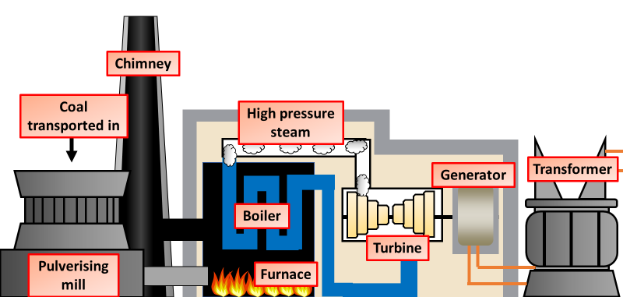

Generating Electricity Question
The diagram below shows some of the main structures in a power station
What is burned in a fossil fuel power station to release energy?
What is the role of the boiler in a fossil fuel power station?
What does the steam turn in a fossil fuel power station?
What device generates electricity in a fossil fuel power station?
Mark Scheme

