Slide 1

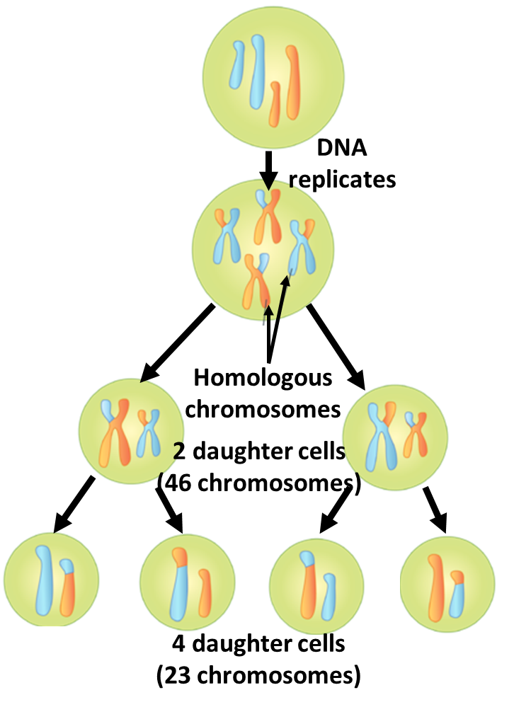

The Great Biology Pubish Quiz
Meiosis

Slide 2

The Great Biology Pubish Quiz
Meiosis
What is the main purpose of meiosis?
A
To produce genetically identical cells
To create gametes with half the chromosome number
B
C
To repair damaged tissues
D
To duplicate somatic cells

Slide 3
The Great Biology Pubish Quiz
Meiosis
During which phase of meiosis does crossing over occur?
A
Metaphase I
Anaphase II
B
C
Prophase I
D
Telophase I

Slide 4
The Great Biology Pubish Quiz
Meiosis
How many daughter cells are produced at the end of meiosis?
A
4
2
B
C
6
D
8

Slide 5
The Great Biology Pubish Quiz
Meiosis
What is the term for the exchange of genetic material between homologous chromosomes?
A
Independent assortment
Segregation
B
C
Mutation
D
Crossing over

Slide 6
The Great Biology Pubish Quiz
Meiosis
Which of the following does NOT occur during meiosis II?
A
Separation of sister chromatids
Reduction of chromosome number
B
C
Formation of four haploid cells
D
Movement of chromosomes to opposite poles

Slide 7
The Great Biology Pubish Quiz
Meiosis
What is the ploidy of the cells at the end of meiosis I?
A
Diploid
B
Tetraploid
C
Triploid
D
Haploid

Slide 8

The Great Biology Pubish Quiz
Light Dependent Photosynthesis
Question 1
B
Question 2
C
Question 3
A
Question 4
D
Question 5
B
Question 6
D

