Slide 1
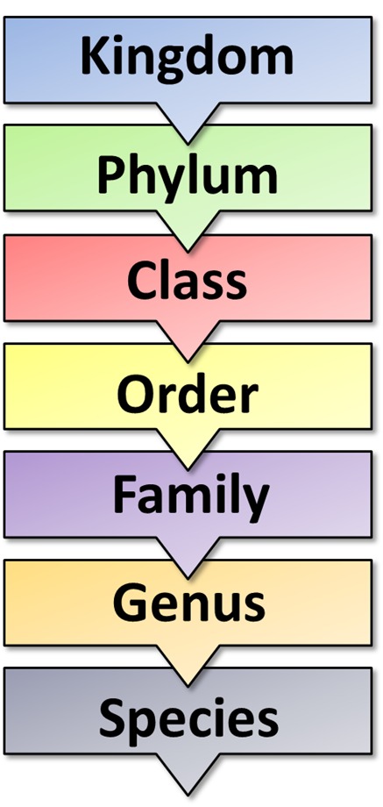

Classification Question
Explain how living organisms are classified, including how modern techniques have improved classification systems.
____________________________________________________________________________________________________________________________________________________________________________________________________________________________________________________________________________________________________________________________________________________________________________________________________________________________________________________________________________________________________________________________________________________________________________________
Answer
Video link

