Slide 1
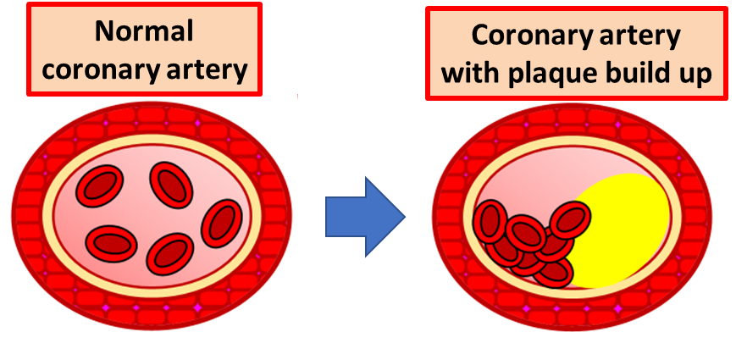

CHD Question
The diagram shows how a fatty plaque builds up in an artery. Describe what coronary heart disease (CHD) is and explain how it can lead to health problems.
Key things to include:
How does a fatty plaque form
What problems does a blockage cause
_______________________________________________________________________________________________________________________________________________________________________________________________________________________________________________________________________________________________________________________________________________________________________________________________________________________________________
Answer
Link to video

