Slide 1
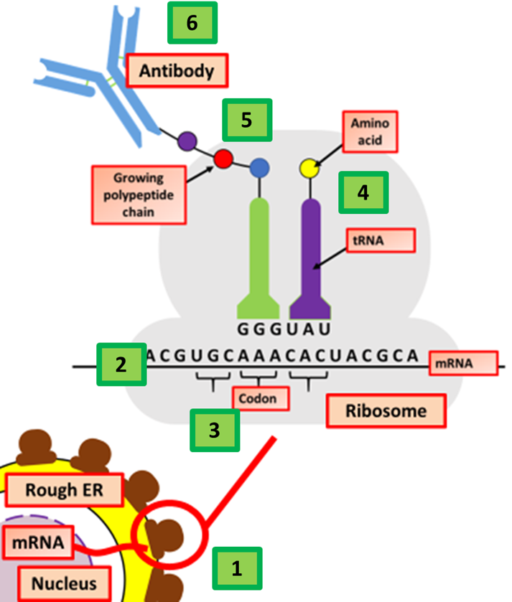

Translation Question
The diagram shows the process of translation. Describe the process of translation in protein synthesis
____________________________________________________________________________________________________________________________________________________________________________________________________________________________________________________________________________________________________________________________________________________________________________________________________________________________________________________________________________________________________________________________________________________________________________________
Answer
Video link

