Slide 1
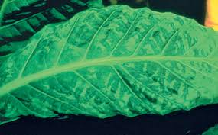

TMV Question
Describe the cause, transmission, and effects of Tobacco Mosaic Virus (TMV) in plants.
____________________________________________________________________________________________________________________________________________________________________________________________________________________________________________________________________________________________________________________________________________________________________________________________________________________________________________________________________________________________________________________________________________________________________________________
Answer
Video link

