Slide 1

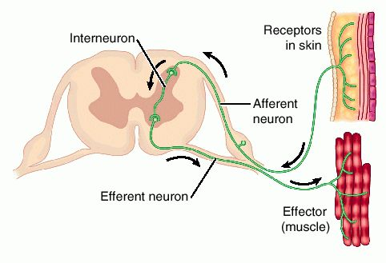
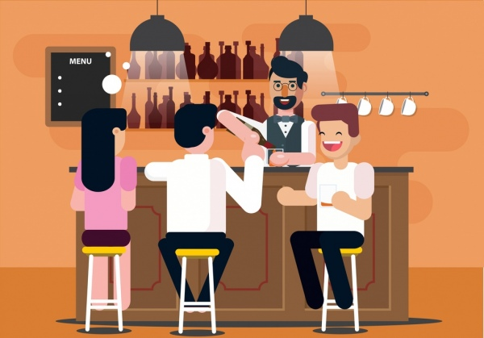
The Great Biology Pubish Quiz
Reflexes

Slide 2
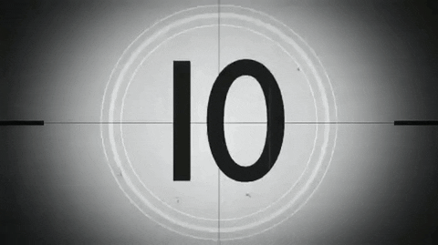
The Great Biology Pubish Quiz
Reflexes
Which type of neurone connects the sensory and motor neurones in a reflex arc?
A
Sensory
Motor
B
C
Relay
D
Effector

Slide 3
The Great Biology Pubish Quiz
Reflexes
What is the correct term for the muscle or gland that carries out the response in a reflex?
A
Effector
Receptor
B
C
Neurone
D
Reflexor

Slide 4
The Great Biology Pubish Quiz
Reflexes
Which part of the nervous system is involved in coordinating reflex actions?
A
Brain
Spinal
B
C
Cerebellum
D
Medulla

Slide 5
The Great Biology Pubish Quiz
Reflexes
What is the name of the pathway taken by a nerve impulse during a reflex?
A
Reflex
Receptor
B
C
Synapse
D
Action

Slide 6
The Great Biology Pubish Quiz
Reflexes
Which structure detects the initial stimulus in a reflex arc?
A
Effector
Axon
B
C
Synapse
D
Receptor

Slide 7
The Great Biology Pubish Quiz
Reflexes
What type of reflex helps maintain posture and balance?
A
Learned
B
Cranial
C
Spinal
D
Postural

Slide 8

The Great Biology Pubish Quiz
Reflexes
Question 1
C
Question 2
A
Question 3
B
Question 4
A
Question 5
D
Question 6
D

