Slide 1
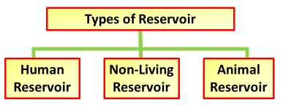

Disease Reservoirs Question
Explain the importance of disease reservoirs in the spread and persistence of infectious diseases.
____________________________________________________________________________________________________________________________________________________________________________________________________________________________________________________________________________________________________________________________________________________________________________________________________________________________________________________________________________________________________________________________________________________________________________________
Answer
Video link

