Slide 1
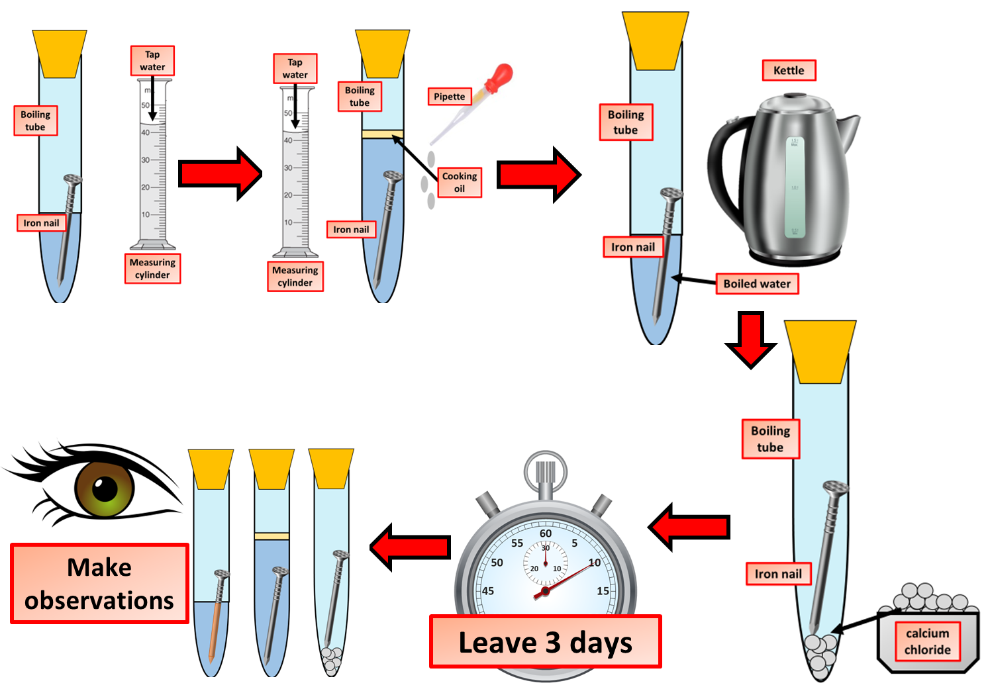

Rusting Practical Question
The diagram shows how a rusting investigation can be carried out
Video Link
What two substances are needed for iron nails to rust?
How could you test if salt speeds up rusting?
Why does painting a nail stop it from rusting?
What happens if a nail is placed in boiled water with oil on top?

