Slide 1
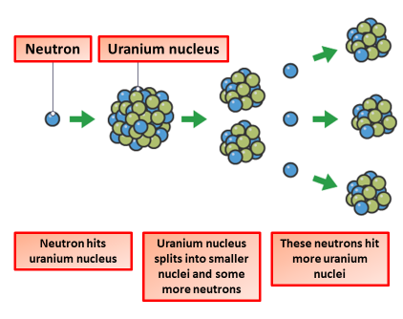

Fission Practice Question
Nuclear fission releases energy.
Describe the process of nuclear fission inside a nuclear reactor.
Key things to include:
How many neutrons does an atom of uranium absorb
What happens to the atoms
What do the atoms release
Answer
_________________________________________________________________________________________________________________________________________________________________________________________________________________________________________________________________________________________________________________________________________
Link to video

Slide 2
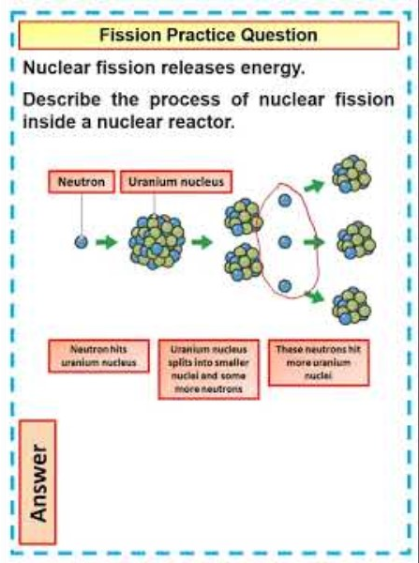
Fission Practice Question

