Slide 1
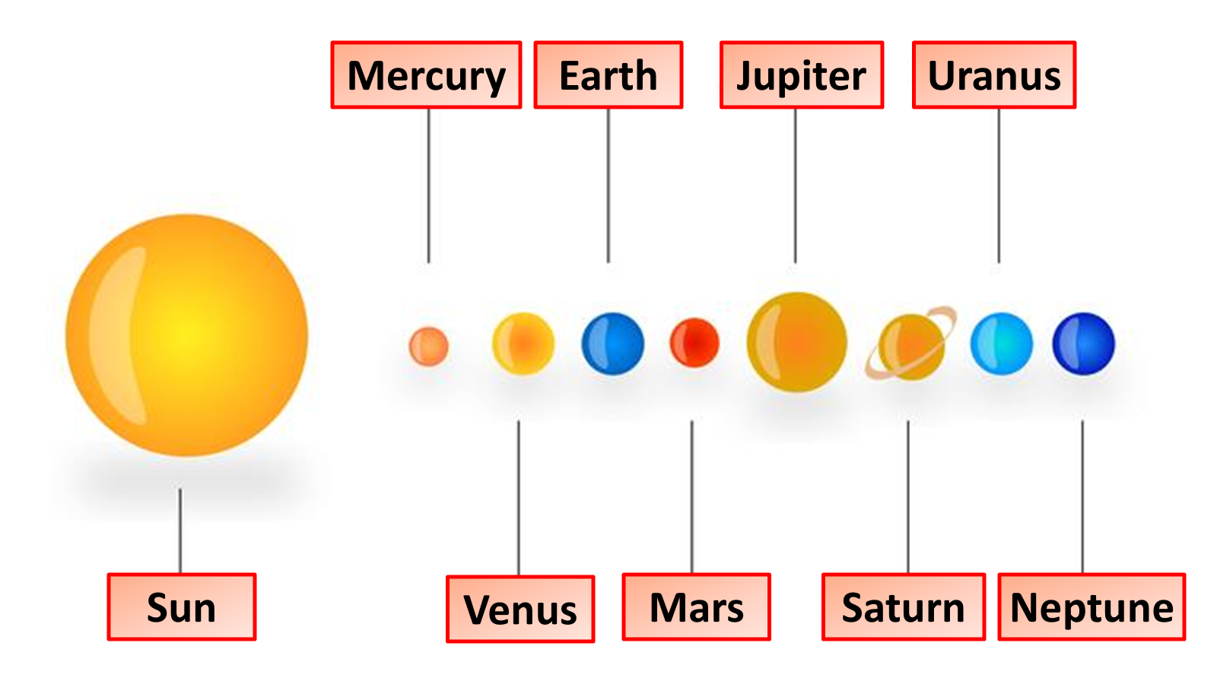
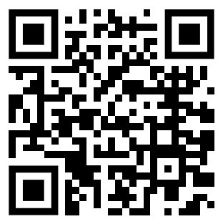
The Solar System Question
Describe the main components of the Solar System and their characteristics.
Key things to include:
What planets are in the solar system
How is the solar system held together
What smaller objects are present
________________________________________________________________________________________________________________________________________________________________________________________________________________________________________________________________________________________________________________________________________________________________________________________________________________________________________
Answer
Link to video

