Slide 1

Ragwort Practice Question
Ragwort is a weed that grows on farmland. Ragwort is poisonous to horses.
Plan an investigation to estimate the size of a population of ragwort growing in a rectangular field on a farm.
Explain how.
Key things to include:
What piece of equipment is used
How can you split the area up
How can you sample randomly
How can you improve accuracy
__________________________________________________________________________________________________________________________________________________________________________________________________________________________________________________________________________________________________________________________________________________________________________________________________________________________________________________________________________________________________________________________________________________________________________________________________________________________________________________________________________________
Answer
Link to video

Slide 2

Ragwort Practice Question

Slide 3

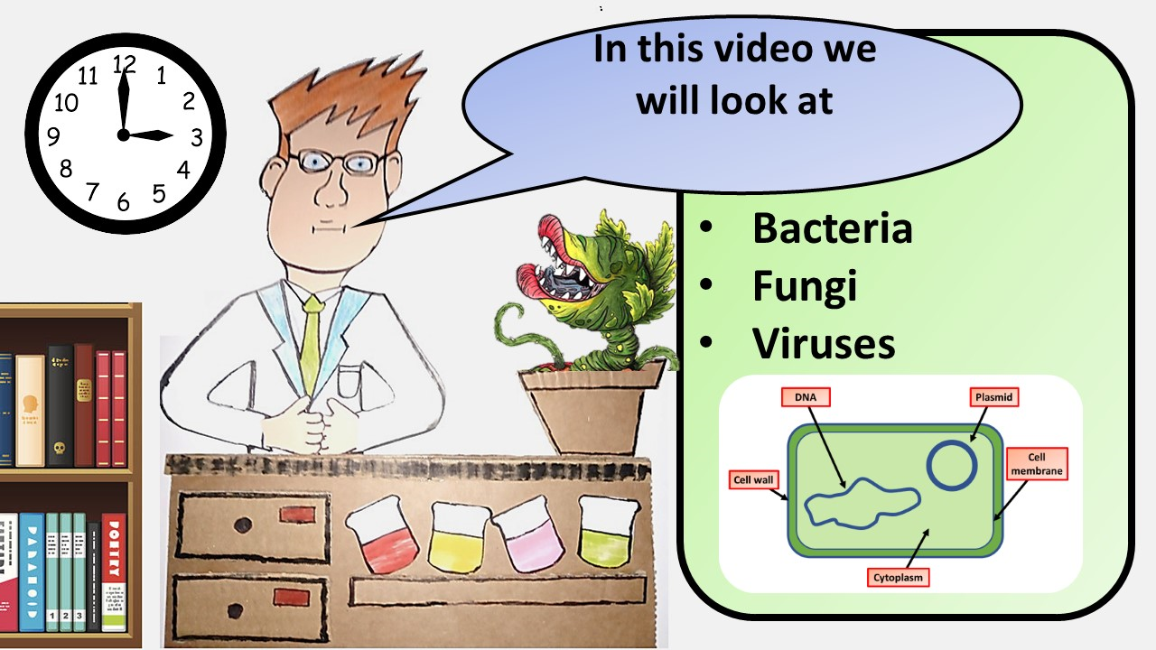


Click here to access my Pathogens youtube videos
Resources that this activity would work well with
Lesson on TES
Lesson on TPT
Follow me on social media to stay in touch
Keep up to date with my new content:

