Slide 1

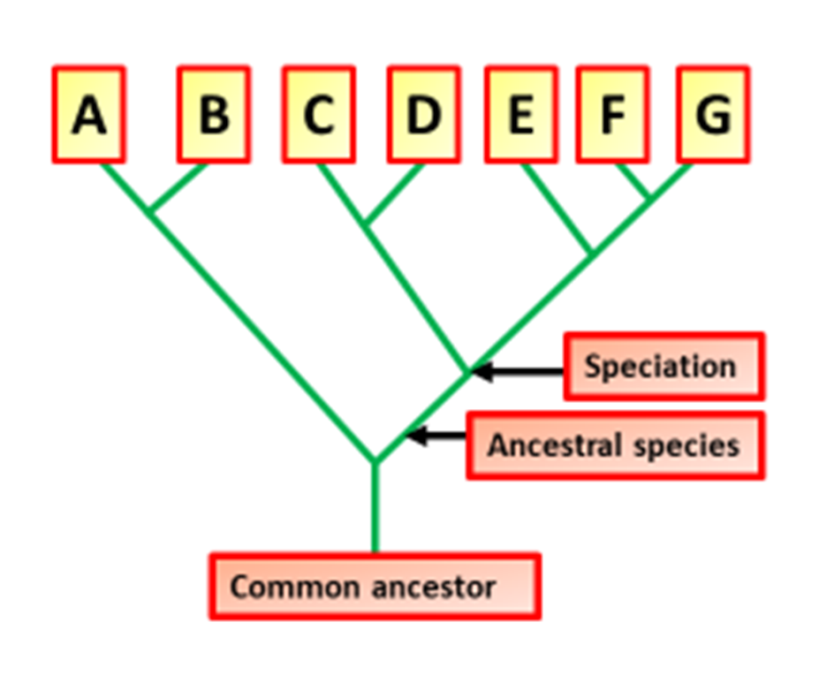

The Great Biology Pubish Quiz
Evidence for Evolution

Slide 2

The Great Biology Pubish Quiz
Evidence for Evolution
Which type of evidence for evolution involves the study of fossils?
A
Molecular evidence
Anatomical evidence
B
C
Paleontological evidence
D
Embryological evidence

Slide 3
The Great Biology Pubish Quiz
Evidence for Evolution
Which of the following provides molecular evidence for evolution?
A
Homologous structures
Vestigial organs
B
C
Fossils
D
DNA and protein sequences

Slide 4
The Great Biology Pubish Quiz
Evidence for Evolution
What does the presence of homologous structures in different species suggest?
A
Common ancestry
Independent evolution
B
C
Convergent evolution
D
No evolutionary relationship

Slide 5
The Great Biology Pubish Quiz
Evidence for Evolution
Which of the following is an example of a vestigial structure in humans?
A
Heart
Appendix
B
C
Liver
D
Lungs

Slide 6
The Great Biology Pubish Quiz
Evidence for Evolution
What type of evolution is shown when two unrelated species develop similar traits due to similar environments?
A
Divergent evolution
Adaptive radiation
B
C
Convergent evolution
D
Speciation

Slide 7
The Great Biology Pubish Quiz
Evidence for Evolution
Which type of evidence for evolution is based on studying the early development of embryos?
A
Paleontological
B
Molecular
C
Embryological
D
Biogeographical

Slide 8

The Great Biology Pubish Quiz
Evidence for Evolution
Question 1
C
Question 2
D
Question 3
A
Question 4
B
Question 5
C
Question 6
C

