Slide 1
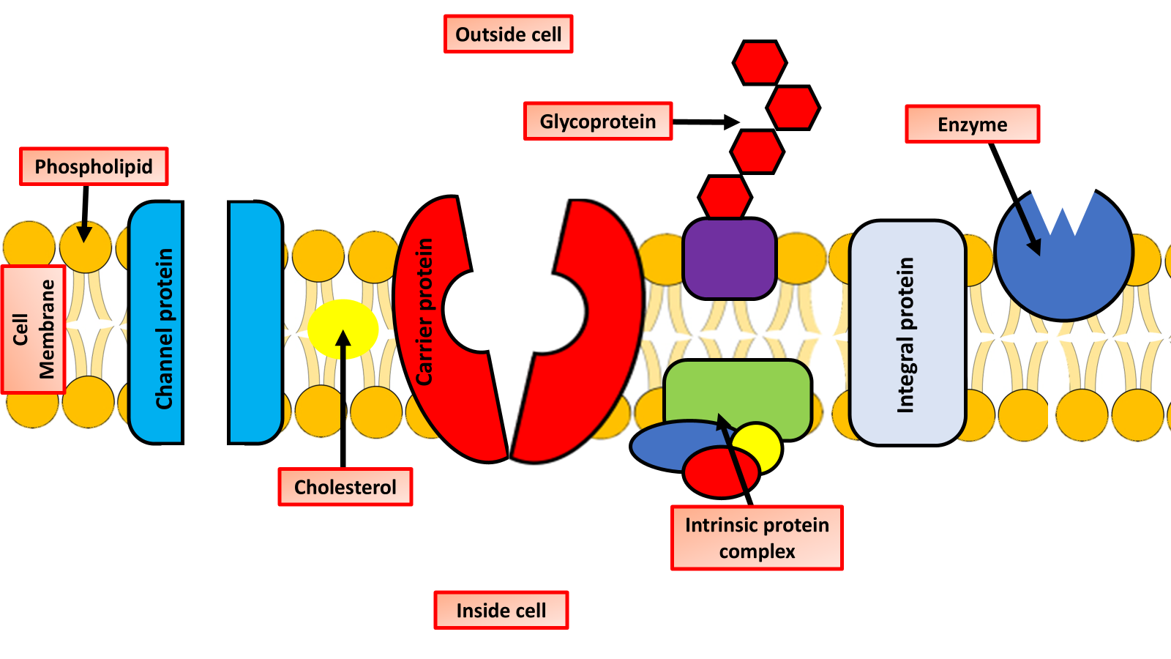

Fluid Mosaic Question
Describe the fluid mosaic model of cell membrane structure.
___________________________________________________________________________________________________________________________________________________________________________________________________________________________________________________________________________________________________________________________________________________________________________________________________________________________________________________________________________________________________________________________________________________________________________________________________________________________________
Answer
Link to video

