Slide 1
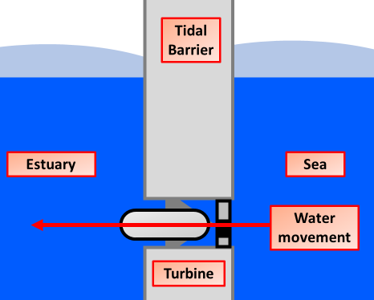

Tidel Power Question
The diagram below shows how electricity is generated using the tides
Explain how electricity is generated using tidal energy.
Key things to include:
What drives the turbine
How is electricity generated
How is the electricity transmitted
___________________________________________________________________________________________________________________________________________________________________________________________________________________________________________________________________________________________________________________________________________________________________________________________________________________________________________________________________________________________________________________________________________________________________________________________________________________________________
Answer
Link to video

Slide 2
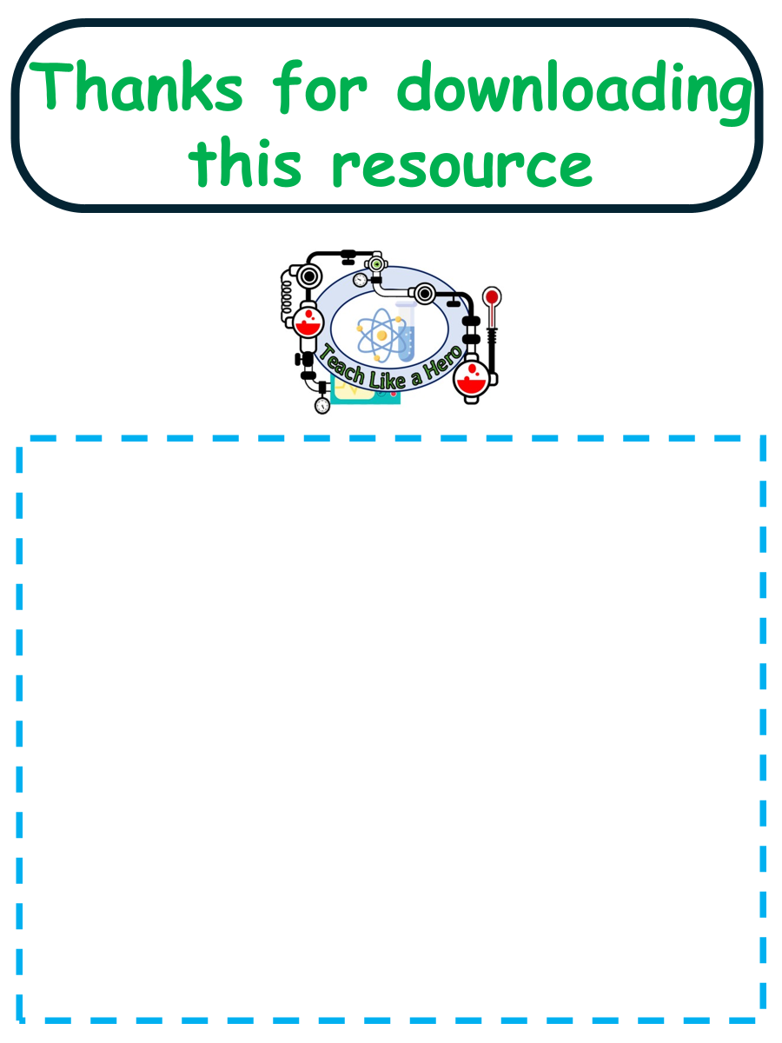
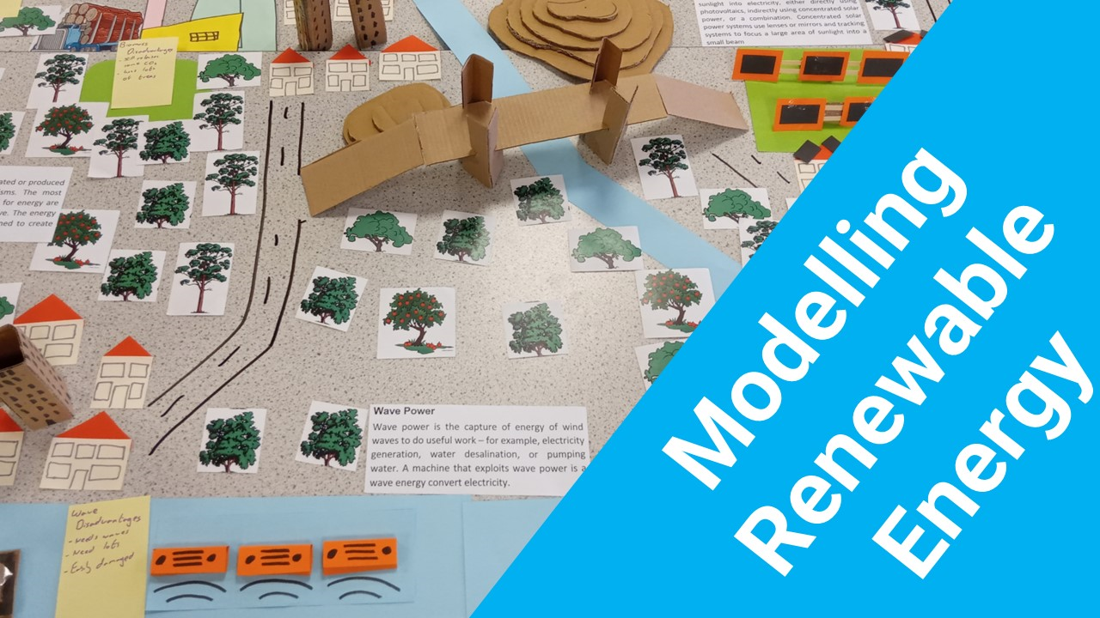


Click here to access my youtube videos
Resources that this activity would work well with
Lessons on TES
Lesson on TPT
Follow me on social media to stay in touch
Keep up to date with my new content:

