Slide 1
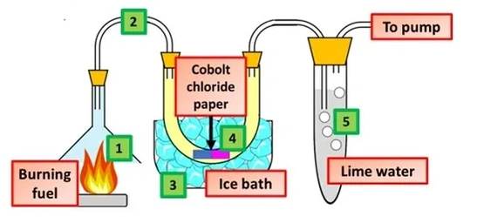

Combustion Question
The diagram shows how the products of combustion can be detected
Video link
What is combustion?
Does the temperature of the surroundings increase or What gas is needed for combustion to occur?
What are the main products of complete combustion of a hydrocarbon?
Does combustion release or absorb energy?

