Slide 1

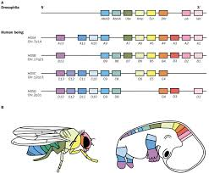

The Great Biology Pubish Quiz
Homeobox Genes

Slide 2

The Great Biology Pubish Quiz
Homeobox Genes
What do homeobox genes control?
A
Metabolism
Immunity
B
C
Development
D
Respiration

Slide 3
The Great Biology Pubish Quiz
Homeobox Genes
Homeobox genes contain a conserved region called the:
A
Enhancer
Intron
B
C
Promoter
D
Homeodomain

Slide 4
The Great Biology Pubish Quiz
Homeobox Genes
Homeobox genes encode which type of protein?
A
Enzyme
Hormone
B
C
Transcription
D
Receptor

Slide 5
The Great Biology Pubish Quiz
Homeobox Genes
Mutations in homeobox genes can cause changes in:
A
Fertility
Morphology
B
C
Temperature
D
Digestion

Slide 6
The Great Biology Pubish Quiz
Homeobox Genes
Homeobox genes are highly:
A
Conserved
B
Variable
C
Methylated
D
Inactive

Slide 7
The Great Biology Pubish Quiz
Homeobox Genes
Which organisms possess homeobox genes?
A
All
Plants
B
C
Animals
D
Fungi

Slide 8

The Great Biology Pubish Quiz
Homeobox Genes
Question 1
C
Question 2
D
Question 3
C
Question 4
B
Question 5
A
Question 6
A

