Slide 1
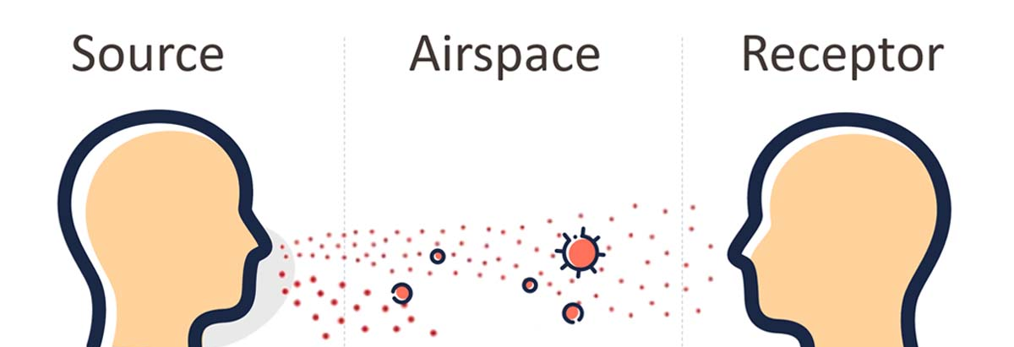

Transmission Factors Question
Describe four factors that affect the transmission of diseases.
____________________________________________________________________________________________________________________________________________________________________________________________________________________________________________________________________________________________________________________________________________________________________________________________________________________________________________________________________________________________________________________________________________________________________________________
Answer
Video link

