Slide 1
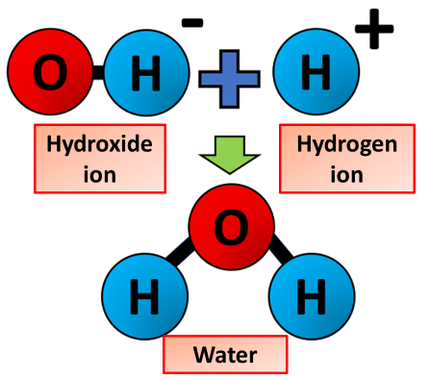

Neutralisation Question
The diagram shows what happens during a neutralisation reaction
Video Link
What type of substance reacts with an acid in a neutralisation reaction?
What is produced when an acid and an alkali react?
What is the pH of a solution after a neutralisation reaction if it is fully neutral?
What type of reaction happens when hydrochloric acid reacts with sodium hydroxide?

