Slide 1

Limiting Factors Practice Question
The rate of photosynthesis in a plant depends on several factors in the environment. These factors include light intensity and the availability of water.
Describe and explain the effects of two other factors that affect the rate of photosynthesis.
Key things to include:
How does temperature affect photosynthesis
What effect does temperature have on enzymes
What effect does carbon dioxide have on the rate of photosynthesis
__________________________________________________________________________________________________________________________________________________________________________________________________________________________________________________________________________________________________________________________________________________________________________________________________________________________________________________________________________________________________________________________________________________________________________________________________________________________________________________________________________________
Answer
Link to video

Slide 2
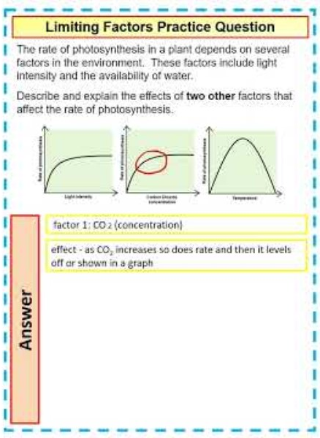
Limiting Factors Practice Question

