Slide 1
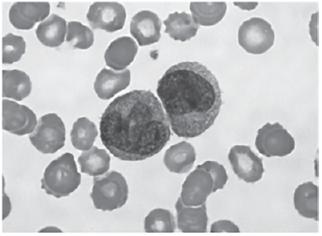

Eyepiece Graticule Question
The image below shows two white blood cells in a blood sample, seen using a light microscope. Explain how to measure the diameter of the nucleus of one of the white blood cells, when observing the cells through a light microscope.
____________________________________________________________________________________________________________________________________________________________________________________________________________________________________________________________________________________________________________________________________________________________________________________________________________________________________________________________________________________________________________________________________________________________________________________
Answer
Video link

