Slide 1
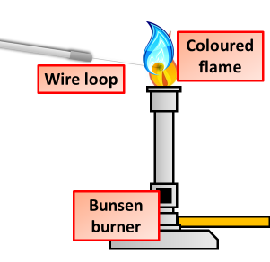

Flame Tests Question
Describe how a flame test can be used to identify metal ions. Give examples of the colours produced.
______________________________________________________________________________________________________________________________________________________________________________________________________________________________________________________________________________________________________________________________________________________________________________________________________________________________________________________________________________
Answer
Link to video

