Slide 1
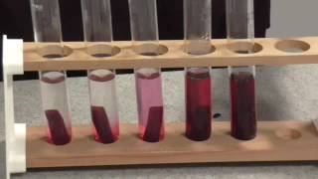

The Effect of Temperature on membrane Permeability Question
Describe and explain how temperature affects the permeability of cell membranes, referring to experimental observations from practical work.
____________________________________________________________________________________________________________________________________________________________________________________________________________________________________________________________________________________________________________________________________________________________________________________________________________________________________________________________________________________________________________________________________________________________________________________
Answer
Link to video

