Slide 1
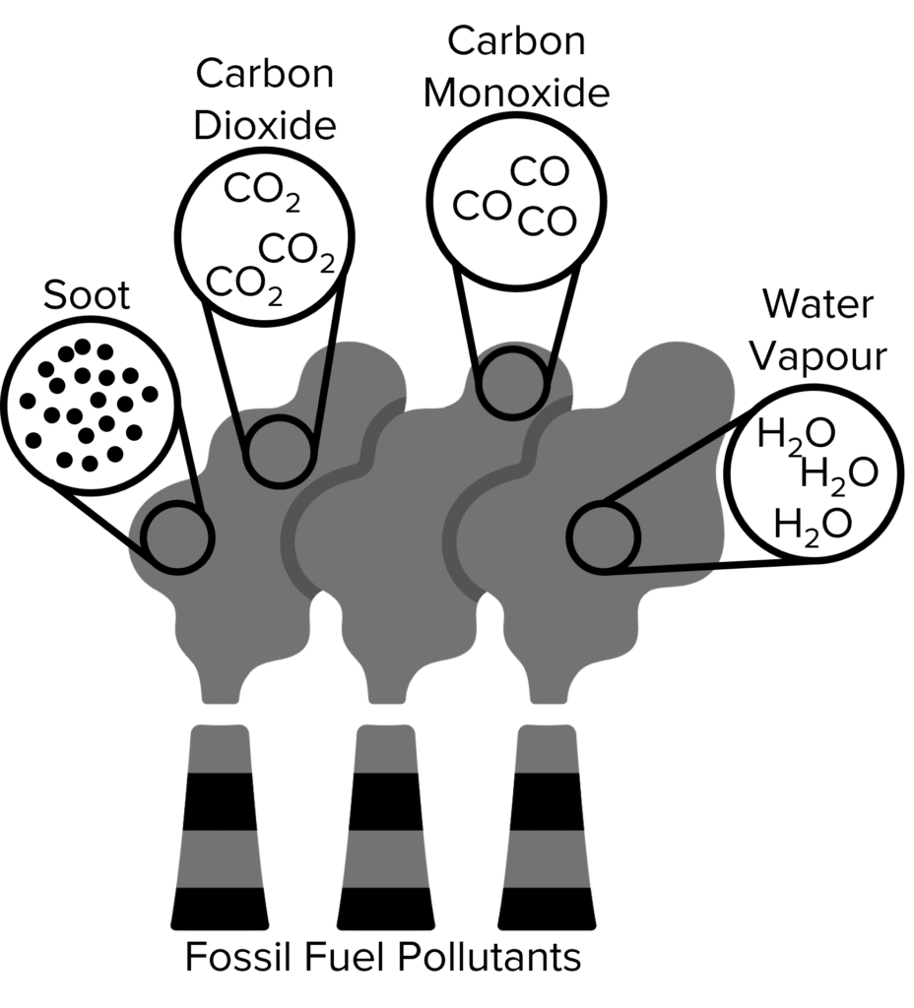

Atmospheric Pollutants Question
The diagram shows some atmospheric pollutants
Video link
What is the main gas released when fossil fuels burn that causes acid rain?
Which gas is produced by incomplete combustion and is harmful to humans?
What are two main pollutants produced by car engines?
How does particulate matter from burning fuels affect human health?

