Slide 1
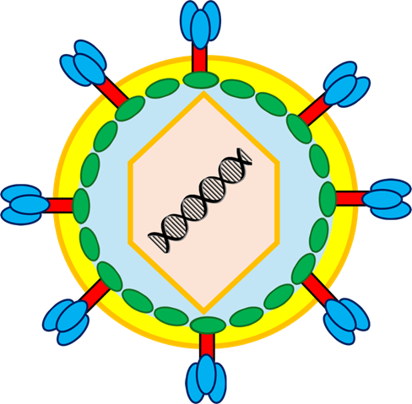
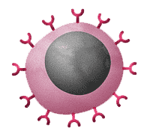
1: HIV enters the body, usually through infected blood or bodily fluids.
HIV infection
3: HIV enters the T cells and uses them to make copies of itself, damaging or destroying the cells in the process.
5: The weakened immune system becomes less able to fight infections and other diseases.
Reduced T lymphocytes
T lymphocyte
HIV Pathogen
Infected T lymphocyte
2: The virus infects white blood cells, particularly helper T cells, which are important for the immune system.
4: The number of T cells gradually decreases, weakening the immune system over time.

