Slide 1
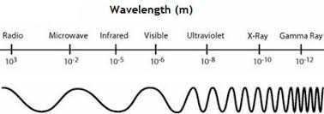

EM Spectrum Question
Describe the electromagnetic (EM) spectrum and its key properties
Key things to include:
What makes up the EM spectrum
What happens to the wavelength
What happens to frequency
_______________________________________________________________________________________________________________________________________________________________________________________________________________________________________________________________________________________________________________________________________________________________________________________________________________________________________
Answer
Link to video

