Slide 1
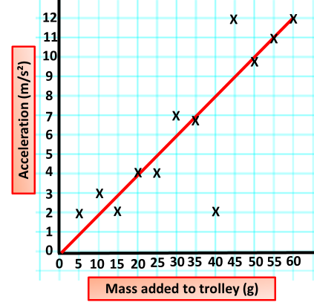
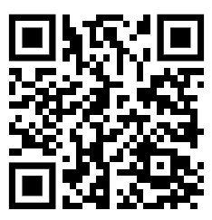
Acceleration Practice Question
The graph below shows the results from an acceleration investigation.
Describe a method the student could use to obtain the results given in Figure 2.
Key things to include:
Dependent variables
Independent variables
Control variables
_______________________________________________________________________________________________________________________________________________________________________________________________________________________________________________________________________________________________________________________________________________________________________________________________________________________________________
Answer
Link to video

Slide 2
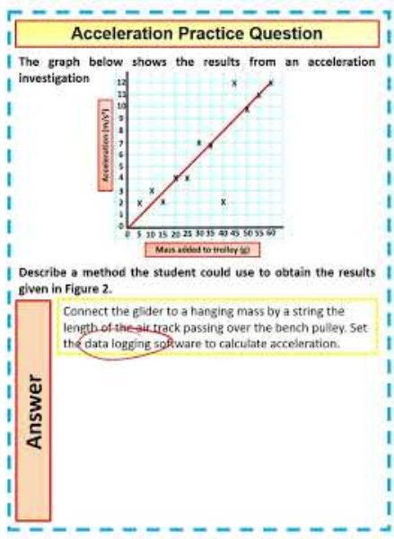
Acceleration Practice Question

