Slide 1

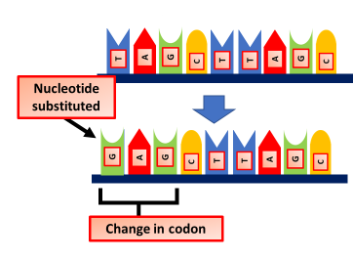

The Great Biology Pubish Quiz
Gene Mutation

Slide 2

The Great Biology Pubish Quiz
Gene Mutation
Which type of gene mutation involves the replacement of one nucleotide with another?
A
Substitution
Deletion
B
C
Insertion
D
Frameshift

Slide 3
The Great Biology Pubish Quiz
Gene Mutation
Which type of mutation results in a premature stop codon?
A
Silent
Missense
B
C
Insertion
D
Nonsense

Slide 4
The Great Biology Pubish Quiz
Gene Mutation
What is the main consequence of a frameshift mutation?
A
Only one amino acid changes
The reading frame is altered
B
C
The protein remains unchanged
D
A stop codon is inserted

Slide 5
The Great Biology Pubish Quiz
Gene Mutation
Which mutation type has no effect on the amino acid sequence?
A
Missense
Nonsense
B
C
Silent
D
Frameshift

Slide 6
The Great Biology Pubish Quiz
Gene Mutation
Which type of mutation is most likely to produce a non-functional protein?
A
Substitution
Silent
B
C
Frameshift
D
Inversion

Slide 7
The Great Biology Pubish Quiz
Gene Mutation
What type of mutation occurs when a section of DNA is reversed?
A
Inversion
B
Deletion
C
Duplication
D
Substitution

Slide 8

The Great Biology Pubish Quiz
Gene Mutation
Question 1
A
Question 2
D
Question 3
B
Question 4
C
Question 5
C
A

