Slide 1
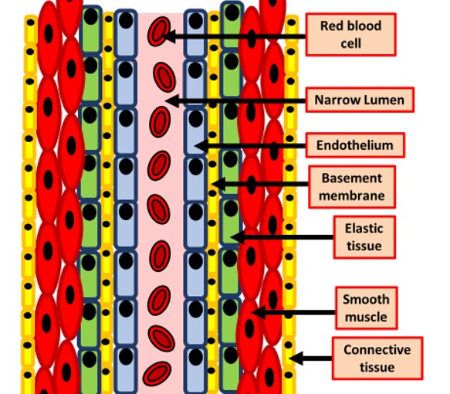

Arteries Question
The diagram below shows the structure of an artery
Explain how arteries are adapted to their function of transporting blood away from the heart.
________________________________________________________________________________________________________________________________________________________________________________________________________________________________________________________________________________________________________________________________________________________________________________________________________________________________________________________________________________________________________________________________________________________________________________________________________________________________________________________________________________________________________________________________________________________________________________
Answer
Link to video

