Slide 1
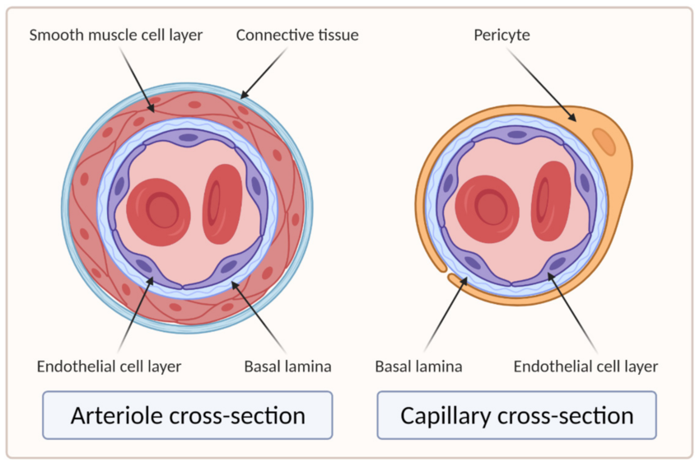

Arteriole Adaptations Question
The smooth muscle content in some arteriole walls is more than double the smooth muscle content in the walls of some arteries. Explain how arterioles are better adapted than arteries to allow the blood to flow into an individual organ.
____________________________________________________________________________________________________________________________________________________________________________________________________________________________________________________________________________________________________________________________________________________________________________________________________________________________________________________________________________________________________________________________________________________________________________________
Answer
Video link

