Slide 1
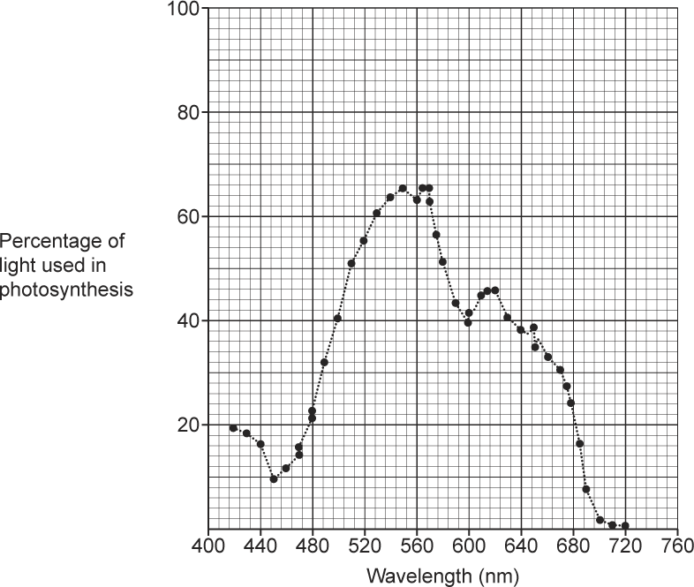

Photosynthesis in Algae Question
The graph shows how algae use different wavelengths of light compared with other plants. Explain how algae are able to use different wavelengths of light for photosynthesis
_____________________________________________________________________________________________________________________________________________________________________________________________________________________________________________________________________________________________________________________________________________
Answer
Video link

