Slide 1
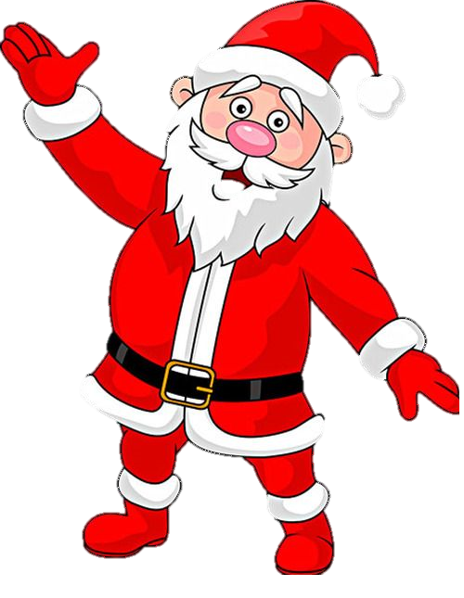
The Science of Santa
Read the text below- highlight any key words
The science of Santa Claus involves some fun physics, biology, and engineering! One of the biggest scientific challenges Santa faces is how he can deliver presents to every child in one night. To solve this, he must travel faster than the speed of light, since there are billions of homes to visit. This requires bending the laws of physics, possibly utilizing a sleigh that can achieve near-light speeds. His reindeer, equipped with special abilities, might help him avoid friction and air resistance, making this feat possible. Santa also uses advanced technology for managing the enormous volume of toys, possibly involving mass production systems like those used in factories. Another intriguing idea is that Santa's sleigh could be equipped with a "time dilation" mechanism, where he might age slower due to traveling at high speeds, explaining how he seems to be able to accomplish so much in such little time. Plus, his ability to fit through chimneys could be explained by quantum physics, where objects can exist in multiple states at once, allowing him to magically shrink and squeeze through small spaces. The science behind Santa Claus taps into imaginative concepts from physics, engineering, and biology to explain how he can defy the impossible!
What scientific challenge does Santa face when delivering presents to every child in one night?
__________________________________________________________________________________________________________
How might Santa's reindeer help him achieve his task?
__________________________________________________________________________________________________________
How could Santa's ability to fit through chimneys be explained by science?
__________________________________________________________________________________________________________

