Slide 1

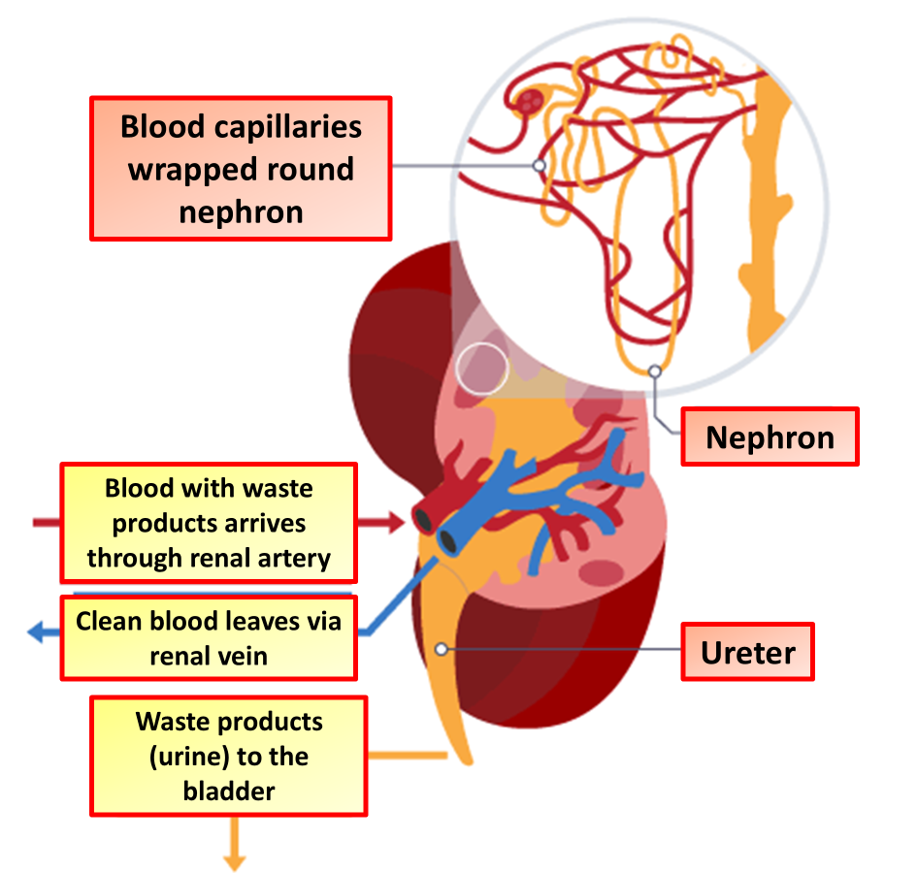

The Great Biology Pubish Quiz
Kidney Structure

Slide 2
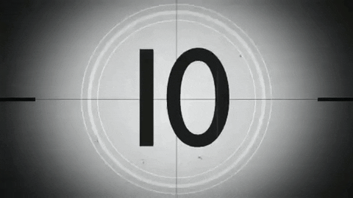
The Great Biology Pubish Quiz
Kidney Structure
What is the functional unit of the kidney?
A
Lobule
Alveolus
B
C
Villus
D
Nephron

Slide 3
The Great Biology Pubish Quiz
Kidney Structure
Which part of the nephron is responsible for filtration?
A
Loop
B
Tubule
C
Duct
D
Capsule

Slide 4
The Great Biology Pubish Quiz
Kidney Structure
What structure collects urine from the nephron?
A
Ureter
Urethra
B
C
Bladder
D
Duct

Slide 5
The Great Biology Pubish Quiz
Kidney Structure
Which blood vessel carries blood into the kidney?
A
Renal vein
Aorta
B
C
Renal artery
D
Portal vein

Slide 6
The Great Biology Pubish Quiz
Kidney Structure
Where does selective reabsorption mainly occur?
A
Capsule
Bladder
B
C
Tubule
D
Ureter

Slide 7
The Great Biology Pubish Quiz
Kidney Structure
Which region of the kidney contains glomeruli?
A
Medulla
B
Cortex
C
Pelvis
D
Ureter

Slide 8

The Great Biology Pubish Quiz
Kidney Structure
Question 1
D
Question 2
D
Question 3
D
Question 4
C
Question 5
C
Question 6
B

