Slide 1
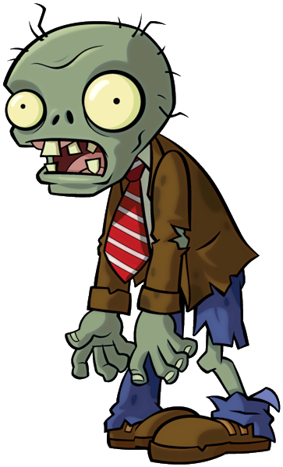
Zombie Science and the Brain
Read the text below- highlight any key words
Halloween is the perfect time to delve into the science behind zombies in pop culture, which may seem far-fetched but has some fascinating real-world parallels. While fictional zombies are portrayed as mindless, reanimated corpses, certain parasites in nature can manipulate the behavior of their hosts in ways that seem eerily similar. For example, the parasite Toxoplasma gondii can infect the brains of animals like rats, causing them to lose their fear of predators such as cats, which then eat the rats and help the parasite complete its life cycle. In humans, Toxoplasma infections have been linked to subtle changes in behavior and even an increased risk of certain mental health conditions.
Additionally, there are fungi like Ophiocordyceps that infect insects, particularly ants, and take control of their movements, effectively turning them into "zombie ants" that behave in ways that benefit the fungus's reproduction. Discussing these real-life examples can help students understand how certain organisms can impact the nervous system and behavior, drawing connections between these biological phenomena and the fictional concept of a “zombie brain.” This topic also offers a unique opportunity to explore how pathogens interact with the brain and how the nervous system regulates behavior, both under normal and infected conditions.
What real-life parasite can alter the behavior of rats, making them lose their fear of predators?
__________________________________________________________________________________________________________
How does the fungus Ophiocordyceps affect insects like ants?
__________________________________________________________________________________________________________
What does discussing organisms like Toxoplasma and Ophiocordyceps help students understand?
__________________________________________________________________________________________________________

