Slide 1
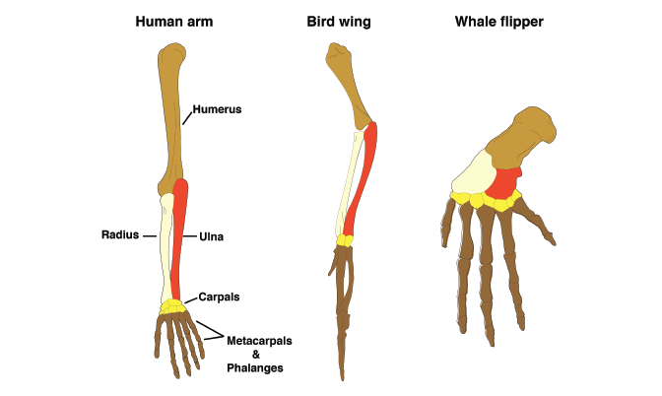

Evidence of Evolution Question
The diagram shows some of the pieces of evidence of evolution. Describe the evidence that supports the theory of evolution.
____________________________________________________________________________________________________________________________________________________________________________________________________________________________________________________________________________________________________________________________________________________________________________________________________________________________________________________________________________________________________________________________________________________________________________________
Answer
Video link

