Slide 1
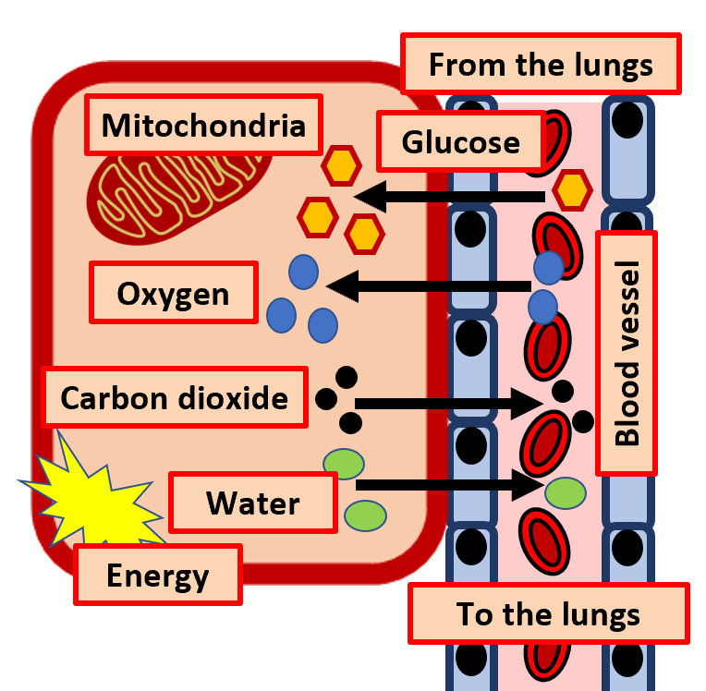

Aerobic Respiration Question
The diagram below shows some of the key aspects about aerobic respiration
Describe what happens during aerobic respiration
Key things to include:
What are the reactants
What are the products
How are substances carried around the body
___________________________________________________________________________________________________________________________________________________________________________________________________________________________________________________________________________________________________________________________________________________________________________________________________________________________________________________________________________________________________________________________________________________________________________________________________________________________________
Answer
Link to video

