Slide 1
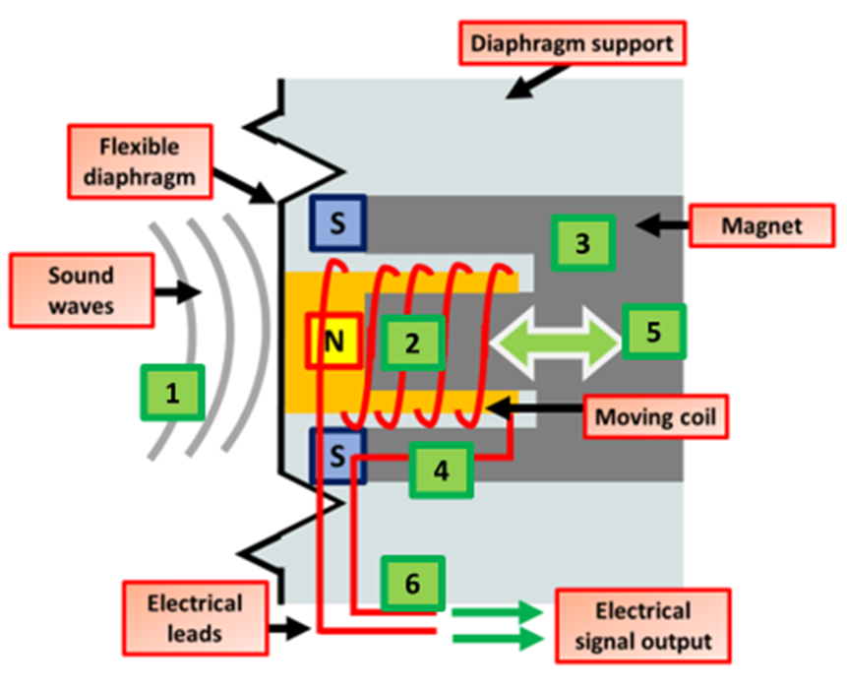

Microphones Question
Explain how a microphone converts sound into an electrical signal.
Key things to include:
How is an AC currentt generated
What changes it’s frequency
_______________________________________________________________________________________________________________________________________________________________________________________________________________________________________________________________________________________________________________________________________________________________________________________________________________________________________
Answer
Link to video

