Slide 1
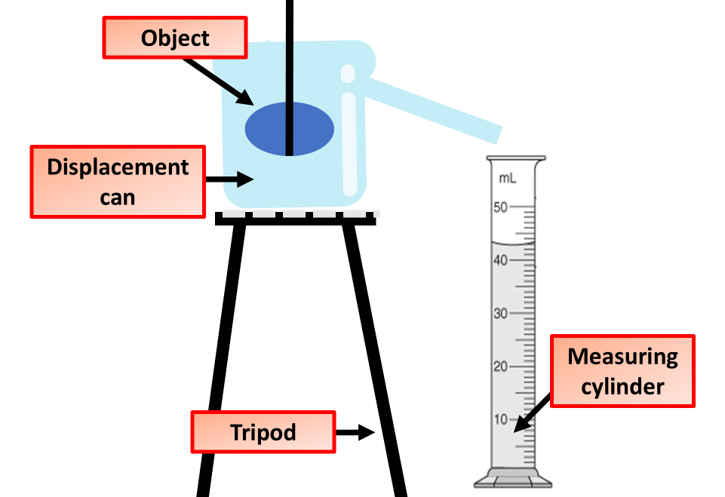

Density Question
Describe how to determine the density of an object and explain the measurements needed
Key things to include:
What is density
How can it be calculated
How is a displacement can used
_______________________________________________________________________________________________________________________________________________________________________________________________________________________________________________________________________________________________________________________________________________________________________________________________________________________________________
Answer
Link to video

