Slide 1
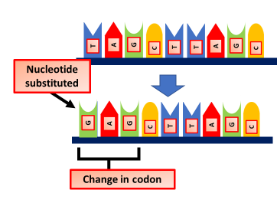
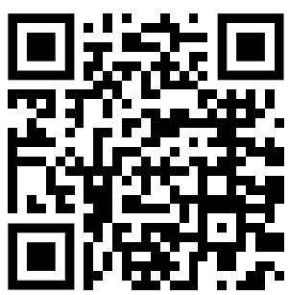
Gene Mutations Question
Describe how gene mutations can affect protein structure and function.
____________________________________________________________________________________________________________________________________________________________________________________________________________________________________________________________________________________________________________________________________________________________________________________________________________________________________________________________________________________________________________________________________________________________________________________
Answer
Video link

