Slide 1
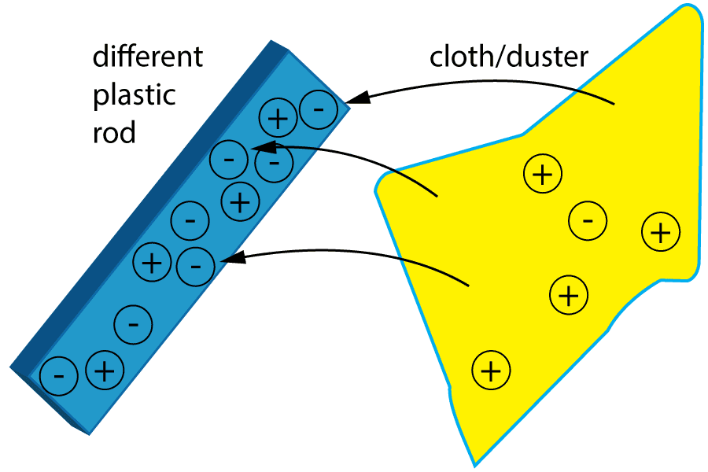

Static Electricity Practice Question
A student rubbed a plastic rod with a cloth.
The rod became negatively charged and the cloth became positively charged.
Explain why the cloth became positively charged.
Key things to include:
How do the electrons move
What charge does that cause
Answer
_________________________________________________________________________________________________________________________________________________________________________________________________________________________________________________________________________________________________________________________________________
Link to video

Slide 2
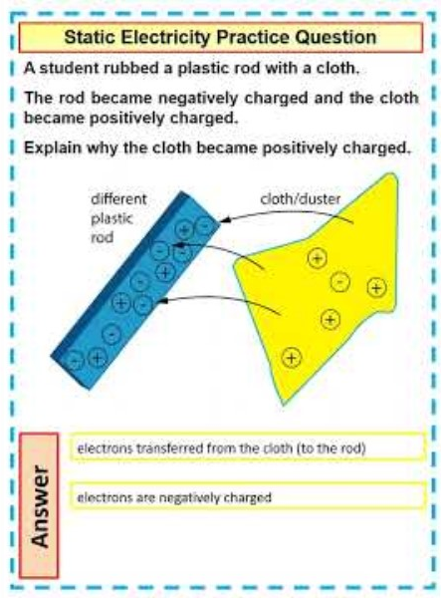
Static Electricity Practice Question

