Slide 1

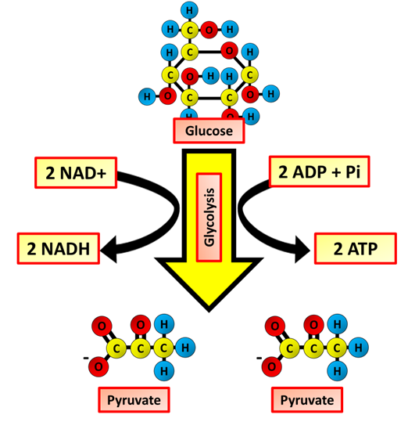
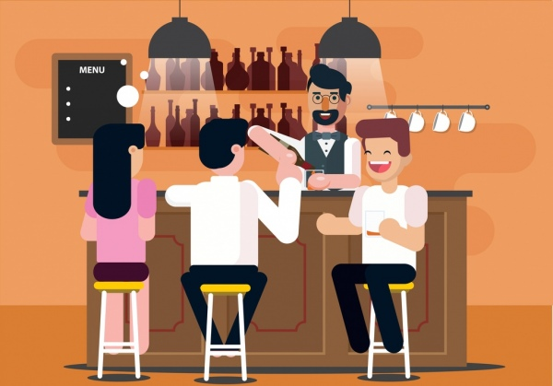
The Great Biology Pubish Quiz
Glycolysis

Slide 2

The Great Biology Pubish Quiz
Glycolysis
Where does glycolysis take place?
A
Nucleus
Mitochondria
B
C
Ribosome
D
Cytoplasm

Slide 3
The Great Biology Pubish Quiz
Glycolysis
What is the end product of glycolysis?
A
Pyruvate
B
Ethanol
C
Glucose
D
Lactate

Slide 4
The Great Biology Pubish Quiz
Glycolysis
How many ATP molecules are used in the first steps of glycolysis?
A
One
Two
B
C
Three
D
Four

Slide 5
The Great Biology Pubish Quiz
Glycolysis
Which molecule is reduced during glycolysis?
A
FAD
ATP
B
C
ADP
D
NAD

Slide 6
The Great Biology Pubish Quiz
Glycolysis
What is glucose first converted into during glycolysis?
A
Hexose bisphosphate
Glucose
B
C
Triose
D
Lactate

Slide 7
The Great Biology Pubish Quiz
Glycolysis
How many net ATP molecules are produced per glucose in glycolysis?
A
One
B
Two
C
Four
D
Six

Slide 8

The Great Biology Pubish Quiz
Glycolysis
Question 1
D
Question 2
A
Question 3
B
Question 4
D
Question 5
A
Question 6
B

